Slide 1
Urban sprawling and related water environmental problems in Huangshui River Basin of Qinghai Province A brief introduction of research schemes on L-THIA-Q and main challenge of its application
Zhao Xia
Qinghai Normal University
Oct. 21, 2015

Slide 2
outline of the report
Origin of the cooperation on L-THIA-Q
Urban related problems in Huangshui River Basin
Research scheme and main challenge
Progress of up-front work
Planning of follow-up work

Slide 3
Origin of the cooperation on L-THIA-Q
Cooperation discussion on provincial and state water resource sustainable development project (Jun. 2014-Feb. 2015)
Professor Filly advised three main cooperation fields
Professor Harbor suggested to focus on Urban and Community Water Planning and Management
Ph.D. Zhao provided a research proposal of Huangshui River Basin
Cooperation agreement on L-THIA-Q and relevant issues (Feb. 2015-May 2015)
Determined the keywords of collaboration: L-THIA-Q and Water Pollution Loading Evaluation
Won a research funding from Qinghai STA
Notes:
1.watershed water resources and water quality modeling
2.water resources planning and management in urban and communities
3.low-cost water purifying in rural area
4.Research Proposal of Water Pollution Loading Evaluation and Water Quality Modeling of Huangshui River Basin in Qinghai Province
5.Qinghai Science & Technology Agency.

Slide 4
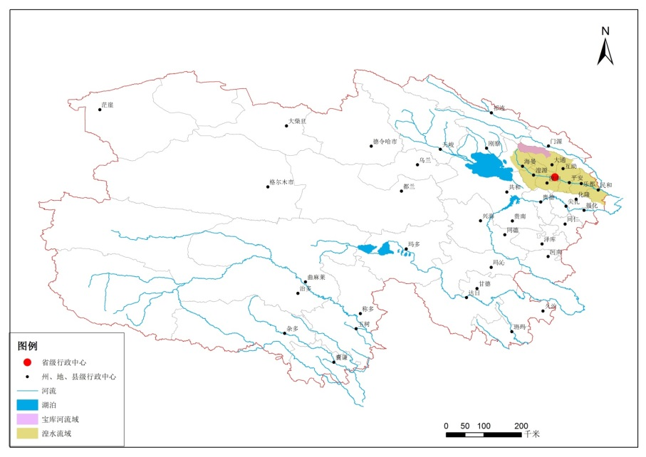
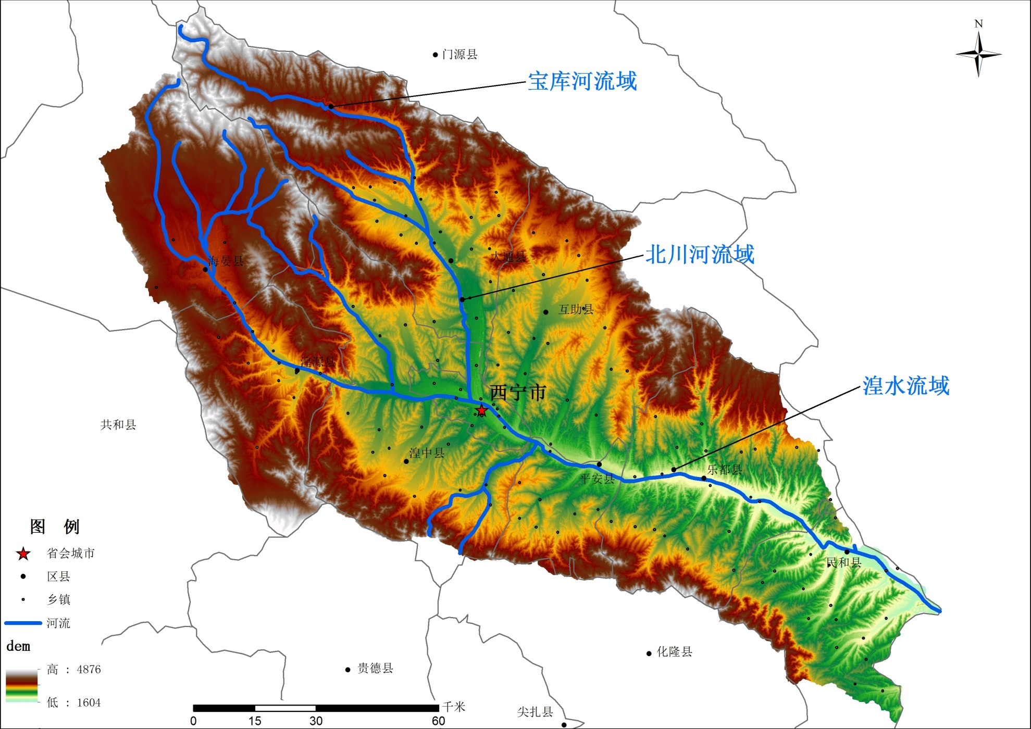
Location of proposed area
Notes:
Huangshui River is the main stream of this watershed,
Beichuan River is the right branch of Huangshui Rirver (a branch of upper reaches),
And Baoku River is also the right branch of Beichuan River(water conservation area of Huangshui River Basin).

Slide 5
Urban related problems in Huangshui River Basin
Hydrological situation of the river
biggest tributary of Yellow River in Qinghai Province, flowing through seven counties and one city with a drainage area of 16120km², which shares 2.2 percent of total land area in Qinghai Province.
Huangshui River is a multi-functional water body, which carries on drinking, irrigating, industry water supply, pollutant receiving, landscape and leisure functions together.
Notes:
1.watershed water resources and water quality modeling
2.water resources planning and management in urban and communities
3.low-cost water purifying in rural area
4.Research Proposal of Water Pollution Loading Evaluation and Water Quality Modeling of Huangshui River Basin in Qinghai Province
5.Qinghai Science & Technology Agency.

Slide 6
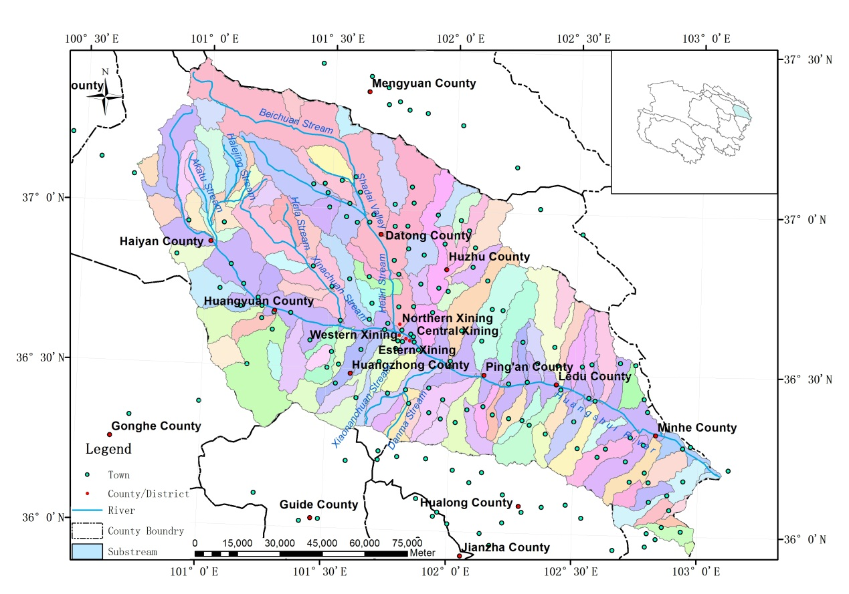
urban and towns in Huangshui Basin
Notes:
Huangshui River is the main stream of this watershed,
Beichuan River is the right branch of Huangshui Rirver (a branch of upper reaches),
And Baoku River is also the right branch of Beichuan River(water conservation area of Huangshui River Basin).

Slide 7
Urban related problems in Huangshui River Basin
Economic status of the area
most important and concentrated economic zone of Qinghai (affording 60% population, 52% farmland, 62% grain yield and 66% industry production)
Environment problems in the area
most polluted and increasing serious of water pollution
the main pollutants in current are NH3-N, BOD and COD
the biggest exceeding rate occurred in main stream
90% length of polluted river appeared below Xining City.
Notes:
1.watershed water resources and water quality modeling
2.water resources planning and management in urban and communities
3.low-cost water purifying in rural area
4.Research Proposal of Water Pollution Loading Evaluation and Water Quality Modeling of Huangshui River Basin in Qinghai Province
5.Qinghai Science & Technology Agency.

Slide 8
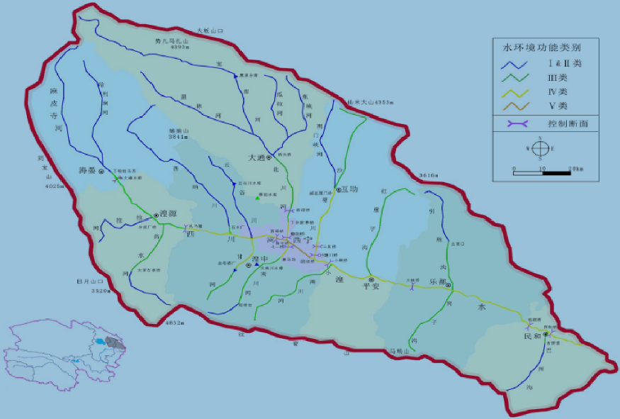
Water function zoning of Huangshui Watershed
Notes:
Huangshui River is the main stream of this watershed,
Beichuan River is the right branch of Huangshui Rirver (a branch of upper reaches),
And Baoku River is also the right branch of Beichuan River(water conservation area of Huangshui River Basin).

Slide 9
water pollution situation of year 2010
1/6 of river length are polluted and 1/3 of monitoring sections are at Grade V or worse than Grade V, and the wastewater discharge takes a share of 70% in annual provincial amount.
Notes:
Huangshui River is the main stream of this watershed,
Beichuan River is the right branch of Huangshui Rirver (a branch of upper reaches),
And Baoku River is also the right branch of Beichuan River(water conservation area of Huangshui River Basin).

Slide 10
Urban related problems in Huangshui River Basin
Management and research work of this river
issuing Water Pollution Prevention and Control Regulations (1992), setting Water Environmental Function Zoning (2004), instituting Comprehensive Governance Agency of Xining Section (2011) and starting regulation projects of Comprehensive Watershed Treatment and Beichuan River etc.
most research focus on contamination status or pollution level, fewer of them used mathematical model to predicting pollutants discharging amount
but none attempted to explore link mechanism between land use change(especially, urbanization and modernizing agriculture) and water pollutant impacts.
Notes:
1.watershed water resources and water quality modeling
2.water resources planning and management in urban and communities
3.low-cost water purifying in rural area
4.Research Proposal of Water Pollution Loading Evaluation and Water Quality Modeling of Huangshui River Basin in Qinghai Province
5.Qinghai Science & Technology Agency.

Slide 11
Research scheme and main challenge
Research area
Beichuan River Basin (3371 km² of drainage area)
Instead of Huangshui River Basin(16120 km²) in view of data availability and feasibility of model calibration and application
Research objectives
Develop a GIS-rooted model of L-THIA-Q which can be used as decision making tools of watershed management in Qinghai Province
Choose a typical river to do some explorative work of water pollution loading evaluation based on concept of TMDL.
Notes:
1.watershed water resources and water quality modeling
2.water resources planning and management in urban and communities
3.low-cost water purifying in rural area
4.Research Proposal of Water Pollution Loading Evaluation and Water Quality Modeling of Huangshui River Basin in Qinghai Province
5.Qinghai Science & Technology Agency.

Slide 12
Progress of up-front work
Works we have done:
Evaluation data demands of model building
data of LUCC, soil type and daily or monthly runoff
design a questionnaire
Including three questions of water environment, two questions of water resource, two questions of land use planning and two questions of water modeling
data of hydrologic features
visiting relative institutions
Including Remote Sensing Monitoring Center and Bureau of Hydrology and Water Resources of Qinghai Province, Environment Protection Agency of Xining City and Huangshui River Basin Commission(Xining Section) etc.
Notes:
1.watershed water resources and water quality modeling
2.water resources planning and management in urban and communities
3.low-cost water purifying in rural area
4.Research Proposal of Water Pollution Loading Evaluation and Water Quality Modeling of Huangshui River Basin in Qinghai Province
5.Qinghai Science & Technology Agency.

Slide 13
Progress of up-front work
Some thing we have found:
identifying management requirements is very critical
Cause “it is often hard for researchers to produce decision support tools that are actually used by planners, managers and decision makers(quoted from Professor Harbor ,Nov.24, 2014 at Xining Symposium)”
But there are several departments that hold on water resource management at same time, who should we server for?
Long-Term Hydrologic Impact Assessment, especially based on the scenario analysis of land use planning is deserved to do, but the result is very difficult to be adopted by the decision-making departments right now.
Notes:
1.watershed water resources and water quality modeling
2.water resources planning and management in urban and communities
3.low-cost water purifying in rural area
4.Research Proposal of Water Pollution Loading Evaluation and Water Quality Modeling of Huangshui River Basin in Qinghai Province
5.Qinghai Science & Technology Agency.

Slide 14
Planning of follow-up work
our goal of L-THIA-Q: to develop a Practical Decision Support Tools in Hydrology and Water Quality which is applicative and useful in Qinghai,
Which should be a GIS-rooted model tools that can help decision makers to analyze and display the implications of different decisions they are trying to make
Which can meet the of evaluation accuracy and sustainable management demand of water resources on the premise of data availability.
Notes:
1.watershed water resources and water quality modeling
2.water resources planning and management in urban and communities
3.low-cost water purifying in rural area
4.Research Proposal of Water Pollution Loading Evaluation and Water Quality Modeling of Huangshui River Basin in Qinghai Province

Slide 15
Scientists’ Approach to
Model Development
Planner and Environmental Managers’ Approach to
Model Use
Generalization Specification
Maximum complexity Simple to use
Small Scale Large Scale
Highly data intensive Readily Available Data
The Answer to a Specific Question (=Decision) with the Best, Easy-to-Use Model, Using Data I Already Have
The Best General Model our Science and Research Grade Data Can Support

Slide 16
L-THIA is one example of a decision support tool
Qinghai Normal University is excited to be working with excellent researchers at Purdue University to pursue a project that will promote sustainable water resource development in Qinghai.

Slide 17
End of the presentation
Thanks for your attending
Welcome questions and suggestions
Reporter: Ph.D. Zhao Xia
Geographic Science Department
Qinghai Normal University
E-mail：zhaoxia-qh@163.com
Mobile phone: 13997060081
Address: No.38 West Wusi Road, West City District, Xining, 810008.

