Slide 1
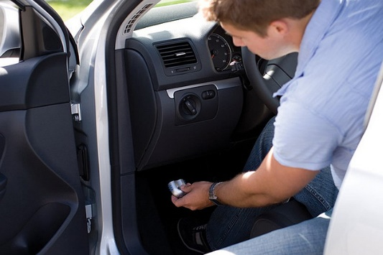
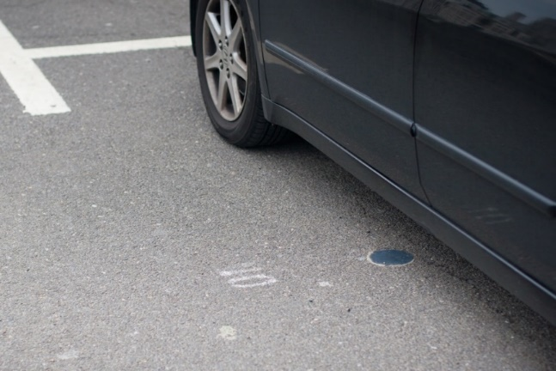
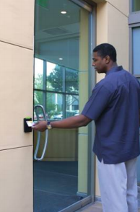
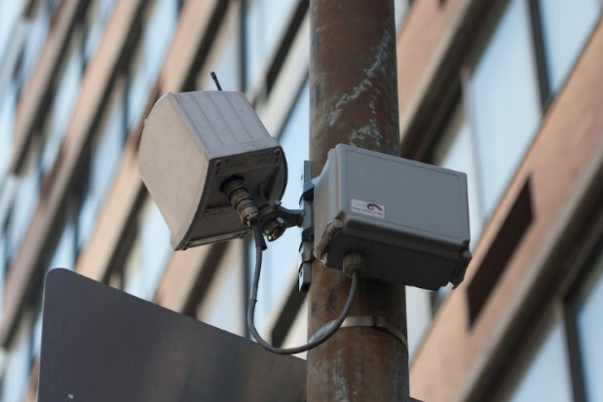
Big Data Drives Smart Cities
Explosive growth in worldwide data collection
Much of this data originates from cities
Enables a wealth of new applications

Slide 2
Smart City Data Issues
Masquerading
Spoofing
Tampering
Common thread: Lack of assurance in
the veracity of smart city sensor data
Desirable to:
Verify data source
Attribute to a user where possible

Slide 3
Potential Solution: Data Modeling
Observe history of past sensor data
Construct a statistical model of prior readings
React when deviations are detected

