Slide 1
Finding the Environmental Footprints of Growing Megacities on DNA/RNA
Shenglong ZHANG, PhD
Department of Life Sciences
New York Institute of Technology
10-21-2015
Notes:
I have to say that I am new to this field of megacities. I am very grateful for the opportunity to be here here with all the experts in the field, and I have learnt a lot in this two day-day workshop. Today I am going to talk about technology we have developed recently, which/It can help to find environmental footprints on DNA/RNA. As we have been talking about these two day, Megacity is a complex issue. As many people talked in these two meeting, such as my colleague, Dr. Nada Anid, and Dr. Bruce Hamilton from NSF, we need bring expertise cross disciplines. Here I am going to report the progress we made in this direction.
DNA/RNA are well known genetic materials to all the live species, and they are our life molecules; the major function of DNA is genetic information carrier, it helps pass genetic information from generation to generation. Therefore it has to be stable enough so that correct information can be passed through generations, from father to daughter; Besides the stability, all the process related to DNA information, from DNA –RNA- to protein, has to be reliable and correct. However, growing megacities brings a lot of changes, and many changes . Therefore we have to ask a question: what change can megacitiies bring at molecular level, especially for important molecules like DNA/RNA?
Growing megacities brings a lot of changes to the environment we are living, our life and ecosystems, some of changes are local, some of them are global; while we are enjoying the convernience that the megacities brings to us, we also need to know, some of good, and some of changes are not good, some of them are even legal to certain species, as we now know there are still many species that donot exist any more in our cities. It is easy if we can directly see the impacts/consequences/visulize the change on our live/body, When the change is legal, and cause immediate death of live species. But most times, the damage of this change is incremental, not easy to see in our life, but inheratable. Recent studies in epigenetics provide us a lot of evidence that enviromental change can leave its markesr on ourDNA/ our genome, such as methylation. To have a whole picuter/ thoroughly understanding the impact of growing megacities, I need to new techinoloy to allow us look at its footprints and understand their consequences.
for a sysmatic sthe syWe What I am interested is to see what the environmental change when growing megacities
DNA sequencing work here, and would like to thank Yuying for the invitation. The title of my talk today is:
It is a very special place for me; I was trained here at the group, coming back here is more like coming home.
Since I am in the city now, I certainly hope that it is just the beginning for us to discuss and exchange ideas.

Slide 2
What changes can megacities bring at molecular level, especially for life molecules like DNA/RNA?
DNA methylation
may be induced by environmental exposures
such as malnutrition, tobacco smoke, air pollutants, metals, organic chemicals, other sources of oxidative stress, and the microbiome, particularly if the exposure occurs during key periods of development.
Cortessis VK, et al.
Hum Genet (2012) 131:1565–1589
Notes:
This is definitely very important question if we really want to understand the consequences of megacity/because DNA/RNA carries important information to all live species on the earth.
Let us start with DNA first. DNA methylation is a well studied modification, it is associated with a broad range of diseases, including cancer, asthma, metabolic disorders and son on. The methylation caused by these environmental factors are inheritable, and abnormal DNA methylation can be have been associated with diseases, it has impact not only on individuals themselves and but also across generations.
----- many to this eniviromental exposure are directly or indirectly related to our topic megacities today.
Unfortunately so to date, this question has not yet been anse
Changes in epigenetic marks such as DNA
methylation and histone acetylation are associated with a
broad range of disease traits, including cancer, asthma,
metabolic disorders, and various reproductive conditions. It
seems plausible that changes in epigenetic state may be
induced by environmental exposures such as malnutrition,
tobacco smoke, air pollutants, metals, organic chemicals,
other sources of oxidative stress, and the microbiome,
particularly if the exposure occurs during key periods of
development. Thus, epigenetic changes could represent an
important pathway by which environmental factors influence
disease risks, both within individuals and across
generations.
Pollution Air and water pollution leads directly to health and nutrition problems. Air pollution results from years of uncontrolled, unregulated industrial production. Suplhur dioxide, nitrogen oxides and other toxic gases continue to pollute the air. Such air pollution is commonly associated with acute and chronic illnesses, such as asthma and bronchitis. Infrastructure failure and the resulting traffic congestion contribute to inefficient fuel use and worsening pollution.

Slide 3
New technologies needed for a systematic assessment
The next major challenge in the modification field is to establish how environmental changes affect modification sets and how these in turn get transduced into various cellular signals.
Helm M; Alfonzo JD. Chemistry & Biology 21, (2014): 174-185
Notes:
DNA methylation is relatively well studied because there are tools available to detect this specific modifiication, such as Chip-chip, disulfite methylation DNA sequencing. However, there are maybe other types modifications existed, but are not easy to detect and study. To systematic assessment the environmental consequence when we grow megacities, we have to develop new technologies that we can
Detect and monitor the change of these modifications as well as their pattern change.
find out their footfrint on our DNA.
Actually,
This modifications are not not limited to DNA,it include RNA as well. So far there are about 107 different naturally occurring RNA modifications, many of them can be induced by environmental change.
This is about DNA, let us also look at other genetic material RNA
Can DNA/RNA genetic materials are stable enough to survive the environmental changes caused by megacities? This is defitely very important question to all live species on the earth.
Unfortunately so to date, this question has not yet been anse
Changes in epigenetic marks such as DNA
methylation and histone acetylation are associated with a
broad range of disease traits, including cancer, asthma,
metabolic disorders, and various reproductive conditions. It
seems plausible that changes in epigenetic state may be
induced by environmental exposures such as malnutrition,
tobacco smoke, air pollutants, metals, organic chemicals,
other sources of oxidative stress, and the microbiome,
particularly if the exposure occurs during key periods of
development. Thus, epigenetic changes could represent an
important pathway by which environmental factors influence
disease risks, both within individuals and across
generations.
Pollution Air and water pollution leads directly to health and nutrition problems. Air pollution results from years of uncontrolled, unregulated industrial production. Suplhur dioxide, nitrogen oxides and other toxic gases continue to pollute the air. Such air pollution is commonly associated with acute and chronic illnesses, such as asthma and bronchitis. Infrastructure failure and the resulting traffic congestion contribute to inefficient fuel use and worsening pollution.

Slide 4
Environmental changes can induce more pseudo U modifications
Meier UT. The EMBO Journal., 2011, 30:3-4
Notes:
Environmental changes can induce more nucleotide modifications, for example, pseudo-uridine.
pseudo-uridine is one of very common RNA modifications, and it has been found in all species. That is the chemical structure.
this is a U2 small nuclear snRNA in splicesome. It usually have 3 modifications here, and the mRNA can splice normally; However, environmental changes, such as nutrient deprivation, or heat shock, can induce two new pseudo-uridine modifications at 56 and 93 positions, of spliceosomal U2 small nuclear snRNA, which can impair pre-mRNA splice, which can cause serious diseases such as cancer.
Because we all grow up and live in very different environments, the change of these markers could be very unique and very personal. They are kind of recording our individual growth. If we can figure out how they changed with our environment, we will be able to regulate these changes. The information in this direction could be very helpful to develop personalized medicine for different diseases.

Slide 5
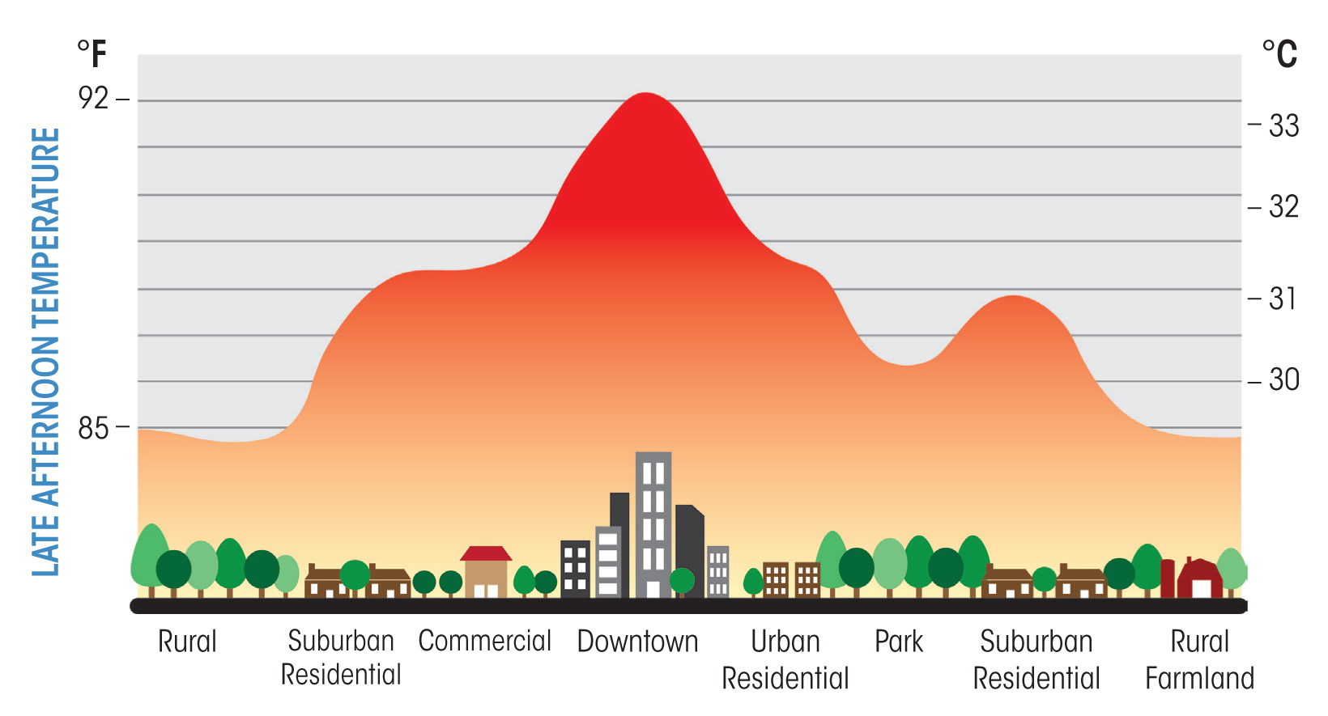
How is the higher temperature in megacities going to affection RNA/DNA?
Profile of an urban heat island
Researchers Find That NYC Urban Heat Island Can Be Up To 8°C Warmer Than Rural Areas
http://www.c3headlines.com/global-warming-urban-heat-island-bias/
Notes:
A more specific question we asked is, for examples, how the higher temperature in megacities is going to affect DNA/RNA?
Like one of my colleagues, professor Jaffrey Raven, from NYIT talked yesterday about higher temperature in airport, as shown in this slide, the temperature in downtown is 3 oC more than rural farmland.
In NYC the city we came from, it can be up to 8 oC warmer than rural areas.
How the high temperature is going to affection RNA and its modifcatins on our life and ecosystems, and it is largely unknown due to lack of technologis to detect RNA modifications. What technologies needed for such studies?
http://www.c3headlines.com/global-warming-urban-heat-island-bias/

Slide 6
What kind of technologies needed for modifications
Detection and analysis tools: Allowing single base resolution to look at modification:
Better understanding of the consequences of megacities on these modification changes
Manage systematically the impact of megacities on our life and ecosystems
What type?
Where are they?
How many are they?
Notes:
What kind of technologies needed?
In order to better understand the consequences of megacities at early stage, we will need tools to detect and analyze the modifications of these modifications.
To look at the modification change, Basely it has to answer three questions at least.
1) what are these modifications? 2) where are they in the genome/transcriptome? And 3) How many are they? Currently available technologies we have, can answer one or two of these questions, but not three of them.
However, It is very important to have all the information so that we can move forward for further understanding how each modification, as well as combinations of different modifications, influences the DNA or RNA function, the research like this will provide scientific evidence to policy makers and colleagues in the field so that we better manage the impact---
in different levels/stages of gene expression.

Slide 7
Direct Sequencing of Modified RNA/DNA by Degradation and LC-MS
What type?
Where are they?
How many are they?
Direct sequencing based upon LC-MS
RNA’s natural tendency to degrade can be exploited to generate a sequence ladder
Notes:
Basically I need tools first to identify our targets, and that brings up three questions about them: 1) what are these modifications? 2) where are they in the genome/transcriptome? And 3) How many are they? Currently available technologies we have, can answer one or two of these questions, but not three of them.
However, It is very important to have all the information so that we can move forward for further understanding how each modification, as well as combinations of different modifications, influences the DNA or RNA function in different levels/stages of gene expression.
To this end, we developed direct sequencing based on LC-MS. Most of current sequencing methods are indirect, for RNA sequencing, we have to synthesize a cDNA. For sequencing cDNA, they need to synthesize another complementary DNA strand ,and the information about modification will get lost during the synthesis. While direct sequencing method we developed can have all the information about modification. RNA’s natural tendency for degradation can be exploited to generate a sequence ladder, which can be resolved by LC-MS for mass sequencing.
For example, Current DNA and RNA sequencing methods are indirect, especially for RNA sequencing, we have to synthesize a cDNA. For sequencing cDNA, they need to synthesize another complementary DNA strand ,and the information about modification will get lost during the synthesis.
Another advantage of the method is that it allows us sequencing modified RNA, because it is a truly direct sequencing method.

Slide 8
Generating ladder oligos for mass determination of RNA
Mechanism of acidic degradation
5’ fragments
Ladder#1
3’ fragments
Ladder#2
Notes:
Here is the mechanism for RNA degradation. At low pH, this (non-bridging phosphoryl) oxygen is rapidly protonated, followed by attack of the 2′-hydroxyl group on phosphorus to give a pentacoordinated species. Proton transfer to the 5′O leads to cleave the 5′-linked nucleotide, the resulting cyclic phosphodiester is not stable and hydrolyzes rapidly to form a 3’-phosphate.
As a result, if we can control the condition well, we will see two ladders, one from 3’-end, one from 5’ –end. Oligos with original 5’-end will always have a 3’-phosphate, and the oligos with original 3’-end will always have 5’-OH.
These two families of peaks do not interfere with each other because they have different mass even they have the same sequence; and these two families can reaffirm each other for mass determination of RNA.

Slide 9
Generating ladder oligos for mass determination of RNA
Well-defined ladders with only one cut randomly along the RNA
Notes:
As a result, if we can control the condition well, we will see two ladders, one from 3’-end, one from 5’ –end. Oligos with original 5’-end will always have a 3’-phosphate, and the oligos with original 3’-end will always have 5’-OH.
Because each of 4 nucleotides and their modifications has its unique mass, by comparing the mass differences between these ladder oligos, we can read out their identity.
These two families of peaks do not interfere with each other because they have different mass even they have the same sequence; and these two families can reaffirm each other for mass determination of RNA.

Slide 10
Working flow to automate LC/MS based RNA sequencing
Björkbom A*, Zhang S*, Lelyveld VS*, Zhang W, Tam CP, Blain JC, Szostak JW. Direct sequencing of modified RNA by two-dimensional LC-MS analysis (Submitted 2015).
* Equal contribution
Notes:
A workflow for direct modified RNA sequencing. (a) An isolated RNA starting material is partially digested in a manner that predominantly generates single-cut fragments. Compounds are identified and extracted from raw two-dimensional mass vs. retention time data. In ion pairing reverse phase HPLC, RNA fragment retention time is dominated by backbone phosphate content, generating an elution peak ladder that correlates with mass. Data quality can be improved by clustering or filtering coeluting mass adducts. An algorithm that traverses compound points can then generate bidirectional alignable reads from random walks along proximal mass differences. Alternatively, a manual analysis of this dataset can verify the algorithm’s results or disambiguate impurity in the starting material. (b) A general reaction scheme for acid-mediated hydrolysis of RNA. (c) A sequenced synthetic RNA (R2) containing two 5-methylcytosine (mC) nucleobases. Solid lines indicate walks automatically traversed by the sequencing algorithm between compounds indicated in black-outlined circles and squares. Letters indicate the base calls made using mass differences observed for each step, with the upper and lower sets arising from the sequencing ladders containing the original 5′ end (5′ ladder, circle) and 3′ end (3′ ladder, square), respectively, of the starting material.

Slide 11
Automation of RNA sequence generation
11
15
5’-AUAGCCCAGUXAGUXUACGC-3’ (X = 5mC)
Björkbom A*, Zhang S*, Lelyveld VS*, Zhang W, Tam CP, Blain JC, Szostak JW. Direct sequencing of modified RNA by two-dimensional LC-MS analysis (Submitted 2015).
* Equal contribution
Notes:
(c) A sequenced synthetic RNA (R2) containing two 5-methylcytosine (mC) nucleobases. Solid lines indicate walks automatically traversed by the sequencing algorithm between compounds indicated in black-outlined circles and squares. Letters indicate the base calls made using mass differences observed for each step, with the upper and lower sets arising from the sequencing ladders containing the original 5′ end (5′ ladder, circle) and 3′ end (3′ ladder, square), respectively, of the starting material.

Slide 12
Correlate RNA modifications with their biological functions
Sample comparing analysis (Urban/Rural)
RNA modifications/other molecular biomarkers
Indicators for early disease diagnosis
better understand and manage the impact of megacities on our life and ecosystems

Slide 13






Acknowledgements
New York Institute of Technology
Aerith Lin
Sophie Liao
Nathalie Cadacio
Jack Godomar
Chun Pong (James) Tam (Harvard)
Professor Jingyue Ju (Columbia)
Professor Jack W. Szostak (Harvard)
Collaborators:
Prof. Samie R. Jaffrey (Cornel Medical School)
Prof. Luísa Miranda Figueiredo (HHMI, IMM, Portugal)
Dr. Katherine Kellersberger (Bruker Daltonics)
Professor Wenjia Li (NYIT)
Notes:
I want to thank my two advisor at Columbia. I want to thank columbia University and NIH for the financial support in sequencing project.
I’d like to thank Jack. It is a privilege and an honor to work with Jack. He is an endless resource for us, and we can always go to him for suggestions when we had difficulty with our experiments.
all the szostak group are very helpful, especially Craig for LC-MS, Na for NMR assistance. I also like to thank sergei in Geron for the NP DNA templates, and Zhen for his help in purchasing starting materials of thio T monomer. Finally I’d like to thank HHMI for financial support, CCIB and Molecular biology at MGH and Harvard medical school, it is a wonderful place for scientific research.
Thank you for your attention.
very generous and supportive, and gives us a lot freedom to explore our idea

