Slide 1



Smart Cities: Challenges and Solutions to Development of Low-Carbon Technologies
Devinder Mahajan
Professor & Co-Director, Stony Brook University, New York, USA
High End Foreign Expert-Energy & Environment, Tongji U., China
Workshop
Food, Energy, and Water (FEW) Nexus in Sustainable Cities
Hotel Regent Beijing, Beijing, China
October 20-21, 2015

Slide 2
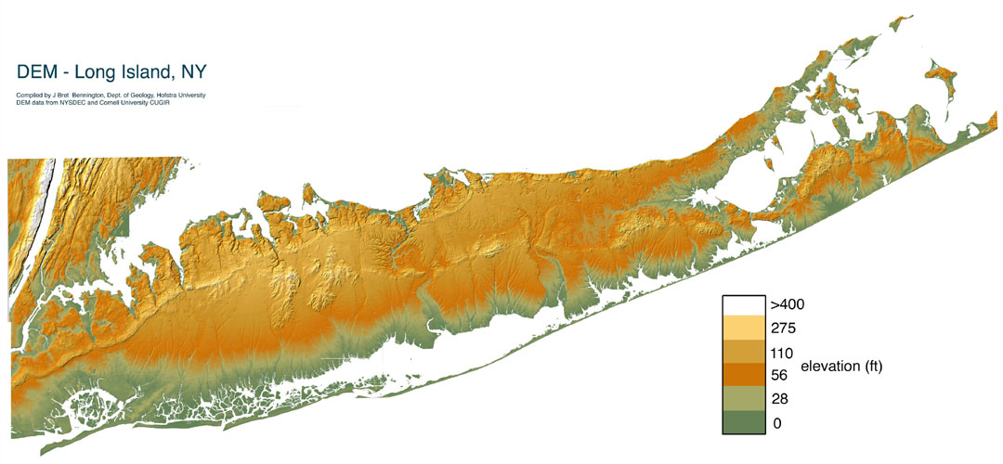
The End
Stony Brook U.
Montauk Point
BNL

Slide 3

ACKNOWLEDGMENTS
■ Institutions Affiliation:
U.S. Department of State- Jefferson Science Fellow
Tongji U., Shanghai- High End Foreign Expert- Energy & Environment
■ Collaborators:
Professors: D. Tonjes (SBU), Chai Xiaoli (Tongji U.), P. Somasundaran ( Columbia U.), S. Turn (U. Hawaii)
Industry: Town of Brookhaven, All Power Labs, Oberon Fuels
■ Funding:
NSF- Center for Bioenergy Research and Development (CBERD)
■ Eco-Secretariat:
U.S.: Department of State / DOE-International
China: NDRC

Slide 4

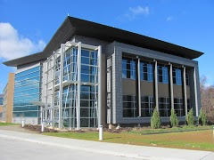
Low-Carbon Energy Management (L-CEM) Group
Housed in a New York State funded $45 million facility dedicated for Energy R&D
12 key faculty and scientists from 6 departments in Stony Brook University (SBU) and Brookhaven National Laboratory (BNL)
2 Senior technical advisors
Over 20 R&D projects in low-carbon R&D
L-CEM Laboratories
Synthesis
Characterization
FUELS R&D
Synthesis & Characterization Laboratory
Process Engineering Laboratory
www.aertc.org
Energy and Water Nexus
Process Simulations
Process Engineering

Slide 5
Newly Released Publication
SPECIAL TOPIC: U.S.-CHINA ECOPARTNERSHIPS: APPROACHES TO CHALLENGES IN ENERGY AND ENVIRONMENT
J. Renewable Sustainable Energy 7 (2015)
PREFACE
Catherine A. Novelli, U.S. Department of State
GUEST EDITORS
Devinder Mahajan, Stony Brook University
Chai Xiaoli, Tongji University
Brian Holuj , EcoSecretariat, U.S.
Wu Hongliang, NDRC

Slide 6
Data Sources
The Golden Age of Gas, IEA 2011
Modern Bioenergy and Universal Access to
Modern Energy Services, UNEP, 2012.
The Future of Natural Gas, MIT Report, 2011
Shell Energy Scenarios to 2050
BP Statistical Review of World Energy, 2011
Beyond Oil and Gas: The Methanol Economy,
G. Olah et al.

Slide 7

Megacities Issues
www.soils.org

Slide 8
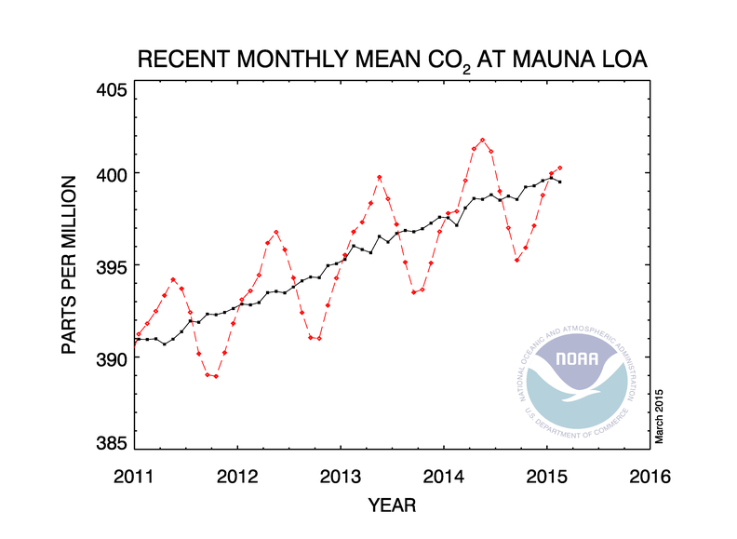
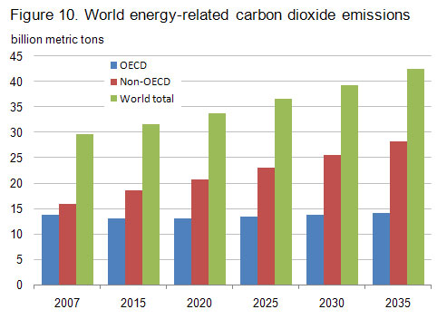
The Climate Issue
  Atmospheric CO₂ level: 401 ppm
  Reference CO₂ level in 1850: 280ppmv
*NOAA: National Oceanic & Atmospheric Administration

Slide 9
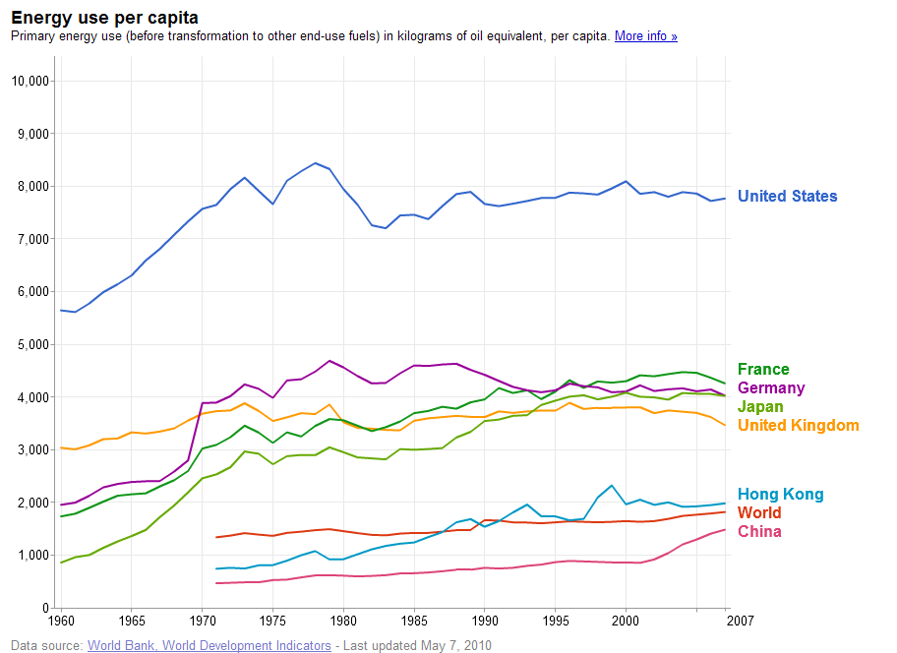
Increasing Energy Demand- Projections
x 2 - 3
+50%

Slide 10
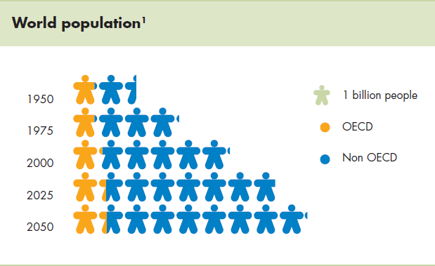
Population Increase- Projections
+50%
x 2 - 3

Slide 11
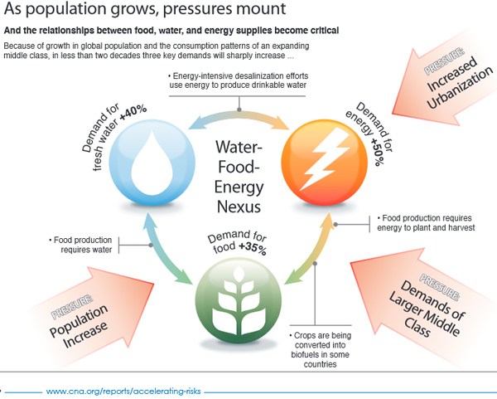
The Food-Energy-Water Nexus

Slide 12
Waste Utilization Opportunities

Slide 13

Black C
CO₂
Process: Combustion
Ash
“Much of the changes in technology and science can be associated with the continual increase in the amount of energy available
through FIRE and brought under control.”
http://www.homeofpoi.com/articles/History_of_fire.php

Slide 14
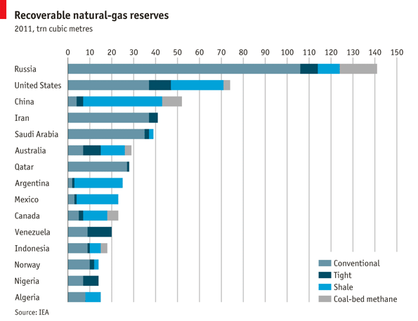
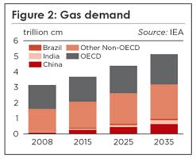
Global Recoverable Natural Gas and Consumption
Recoverable gas: > 550 tcm
With over 250 years of reserves available, the fossil fuels share will drop from 81% to 74% by 2035.
The Economist, 2012 data

Slide 15
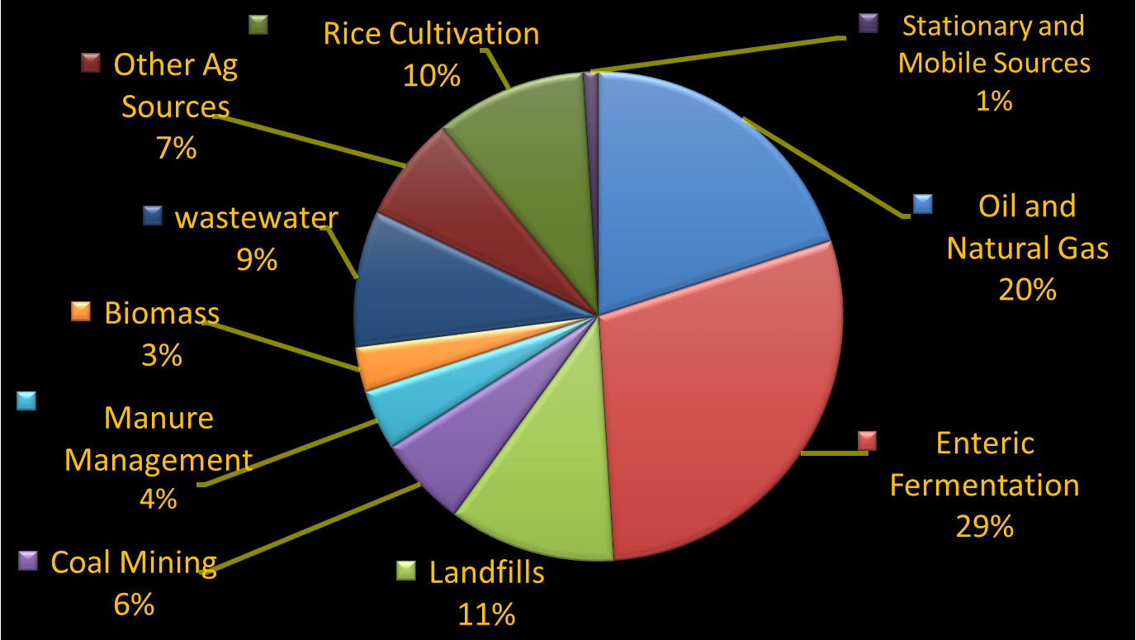
Global Anthropogenic Methane Emissions (by Source)
U.S. EPA (2006) EPA 430-R-06-003, revised 2012

Slide 16
Facts about Methane Release*
GHG Effect: CH₄ ~ 21 (CO₂)
Fugitive CH₄ release data (2013)
Global: 882 bcm or 27% of total global CH₄ consumption
CH₄ contribution to total global GHG emissions: 15%
Landfills: 30-90 bcm (105 – 315 mboe)*
US Landfills
#3 source of anthropogenic CH₄ emissions
17.7% of all CH₄ emissions (103 MMTCO₂e)
■ New White House strategy to curb CH₄ emissions from landfills, agriculture (35%), Coal mines and Oil & Gas operations (28%) to be developed (April 2014)
China
352 MT MSW (50% in landfills)
■ If increased to 70%, 40-80 bcm CH4 will be available as a renewable energy source
*Miller et al., PNAS, 2013

Slide 17
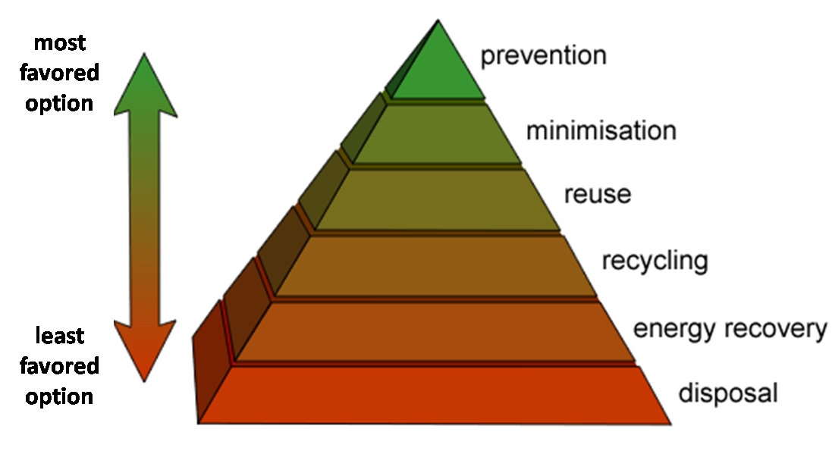
Waste Management Options
http://www.bassettdemolitions.com.au/active-recycling/

Slide 18
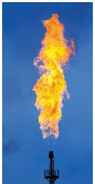
Flared Natural Gas
134 bcm gas is flared annually
~5% of total global gas usage
= 400 mt or 2% of total global CO₂ emissions
Global Gas Flaring Reduction (GGFR) Initiative
Policy Issues
Limited access to international or local gas markets
Lack of financing for infrastructure
Undeveloped regulatory framework.
► Oil Displacement potential = 1.4 mbd
www.youtube.com/watch?v=miOJ86B4xe8
World Bank

Slide 19
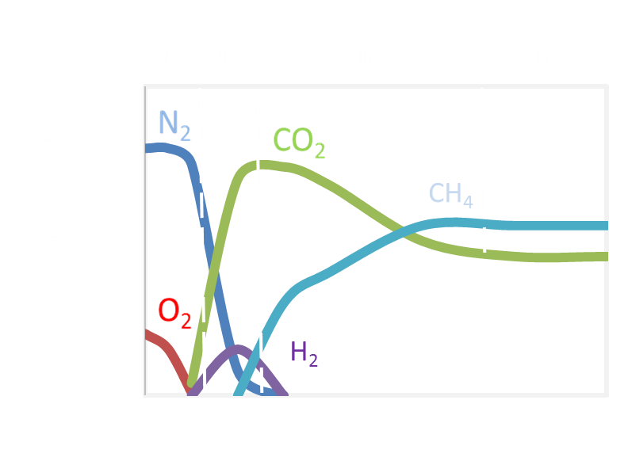
Methane Production from Landfills

Slide 20
Biogas Composition
Component | % Content
CH₄* | 55-70 (v/v)
CO₂* | 30-45% (v/v)
H₂S* | 200-4000 ppm (v/v)
NH₃** | 0-350 ppm
Humidity*** | Saturated
Energy Content* | 20-25 MJ/m₃
*RISE-AT (Regional Information Service Center for South East Asia on Appropriate Technology), 1998. Review of current status of
anaerobic digestion technology for treatment of municipal solid waste.
** Strik, D.P.B.T.B. et al., 2006. A pH-based control of ammonia in biogas during anaerobic digestion of artificial pig manure and maize silage.
Process Biochemistry 41, 1235-1238
*** Rakičan, 2007. Biogas for farming, energy conversion and environment projection
Courtesy: M. Smith, USDA, 2009

Slide 21
Potential of Biogas: A Long Island, New York Study
■ In New York State, 65% of the waste stream is composed of degradable items in the form of paper and organics.
Biogas Sources on Long Island
Landfills: MSW, C&D, and Yard Waste
Wastewater treatment plants: Sewage sludge
Agricultural residues: Plant waste and animal manure
MSW
3.5 million tons of waste produced annually
  Recycled: 1 million tons
  Incinerated: 1.5 million tons
  Transported off Long Island: 1 million tons
■ S. Patel, D. Tonjes and D. Mahajan. Biogas potential on Long Island, New York: A quantification study. J. Renewable Sustainable Energy 3,(2011); doi: 10.1063/1.3614443.
Notes:
-Here on Long Island I have identified 3 potential sources.
-landfills which I divided into MSW, C&D, and yard waste
-Wastewater treatment plants
-agricultural reside

Slide 22
Biogas Sources on LI
Potential Source | Currently Exploited | Current/Potential CH₄ Yield, bcf | Optimal Use | Technology Barriers
Sludge | No | 2.49 | Pipeline quality | ADs needed
LGRF | Yes | 1.64 | Electricity | Upgrading
MSW | No | 1.29 | Pipeline quality | AD; Upgrading
C&D | No | 1.23 | Pipeline quality | Upgrading
Agriculture Waste | No | 0.88 | On-site usage; Electricity | ADs needed
Yard Waste | No | 0.17 | On-site usage | ADs needed
Conclusions
Total annual biogas potential: 224 million m³
Equals 2.3 Twh of electricity or 12% of total generated on Long Island from natural gas.
Notes:
-Examine the landfills identified by the EPA as potential candidates for energy project
-Investigate the effects of recirculation of leachate in biomass as well as its potential use in Ads
-Consider anaerobic digestion in terms of waste management at WWTPs
-Develop biogas upgrading technology for higher heating values

Slide 23
Biogas vs Natural Gas
Molecule | Biogas % | Natural Gas %
CH₄ | 50-75 | 70-90
CO₂ | 25-50 | 0-8
N₂ | 0-10 | 0-5
H₂ | 0-1 | Trace
H₂S | 0-3 | 0-5
O₂ | 0-2 | 0-0.2
C_{n} (n = 2,3,4) | Trace | 0-20%
Notes:
-Biogas is a combustible gas produced when organic matter is subjected to anaerobic conditions.
-What makes biogas so interesting the large amount of Methane it contains as you can see and this is why it makes a good substitute for natural gas.
-The exact composition of biogas ranges based on source it is extracted from.

Slide 24
Waste Utilization: Science & Technology
Challenges
For known pathways of waste utilization, the amount of energy input is too large to be economical. Processes that are economical at small scale are desired.
Solutions
Skid-mounted units
Flexible chemistry to sequentially produce multiple products

Slide 25
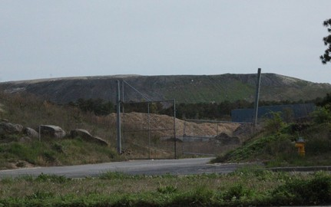
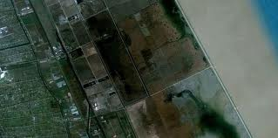
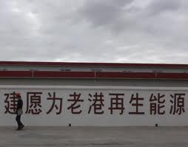
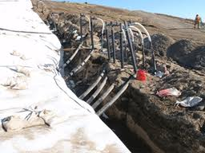
Biogas Utilization
► 1 of 30 projects under the U.S. - China Energy & Environment Program
Landfill: Town of Brookhaven Laogang
Long Island, New York Shanghai, China
CH4, m³/d: 28,000 200,000
Use: Power Power

Slide 26

Biogas to Fuels: Reaction Sequence
CO₂
- H₂S
CO₂
CH₄
CH₄
CNG
PSA
- S
MeOH
DME
Gasoline

Slide 27
Biogas Utilization- Step 1: S Removal
Known Processing Options
Adsorbents
Metal sponges
Limitation: Stoichiometry (1/1)
Challenge: Increase stoichiometry (>1)
Our System (Under Development)
Increased stoichiometry.
Results confirmed in the laboratory.
Pre-Patent application filed 2015.
Status
Ready for demonstration at the landfill site

Slide 28
Biogas Conversion- Step 2: Biogas to Fuels
Challenges:
1. How to develop peak shaving fuels for power production?
2. How to utilize small or remote gas fields?
Solution
Total C utility with product specificity.
Skid-mounted units are needed.
Approach:
Process Chemistry
Single-site or Nano-sized catalysts
Process Engineering
Slurry-phase for better heat management

Slide 29
Low Temperature Waste Heat Utilization
Eco-Energy City Concept- Japan (2000)
Goal: Utilize low temp. waste heat (T <100oC)
Reaction: CO + 2 H₂ ↔ CH₃OH
Notes:
-Biogas is a combustible gas produced when organic matter is subjected to anaerobic conditions.
-What makes biogas so interesting the large amount of Methane it contains as you can see and this is why it makes a good substitute for natural gas.
-The exact composition of biogas ranges based on source it is extracted from.

Slide 30
Ideal Methanol Synthesis Process

Slide 31
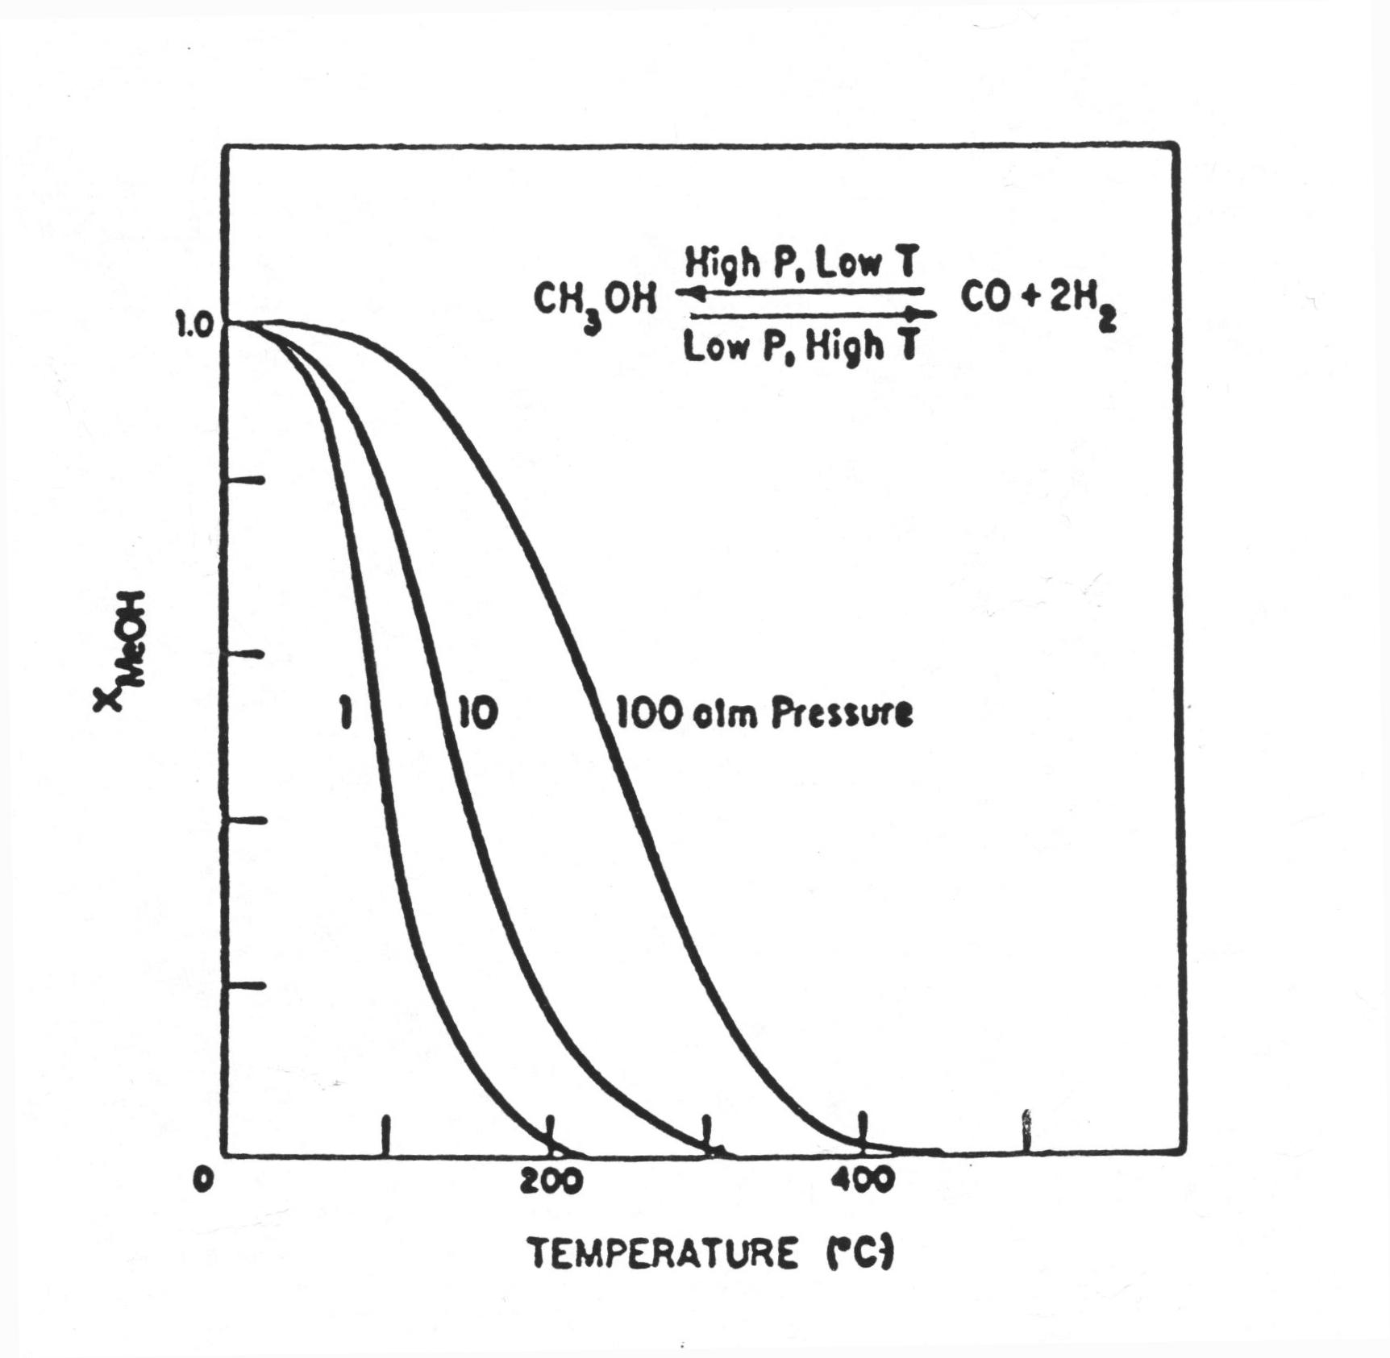
Methanol Conversion- T & P Dependence

Slide 32
BNL Methanol Synthesis- Attributes
Catalyst in liquid phase (2-phase G/L reaction)
Low Temperature (<150ºC)- Overcomes Thermodynamic
limitations
Liquid phase- heat management
Low pressure operation and inertness to N₂– No O₂-
separation plant required
High conversion (>90%) per pass- No gas recycle
*Mahajan. U.S. Patent # 6,921.733 (2005)

Slide 33
Biogas-to-Fuels Conversion
Advanced H₂S removal technology
Process maximizes C utilization by co-processing CH₄ and CO₂ in biogas.
Liquid Fuels Technology Options
  Biogas to DME (a diesel substitute).
  Biogas to Gasoline
Focus on skid-mounted / Off-grid plants.
  1 mscf gas/d; 4500 gallons /d DME

Slide 34
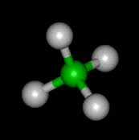
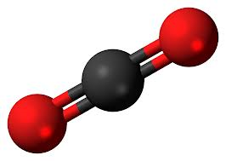
Fugitive Methane
MoST, China Sponsored Workshop
“Control, Harvesting and Utilization of Fugitive Gases”
Beijing, CHINA
September 24, 2014
Interplay between two molecules
CH₄
CO₂

Slide 35
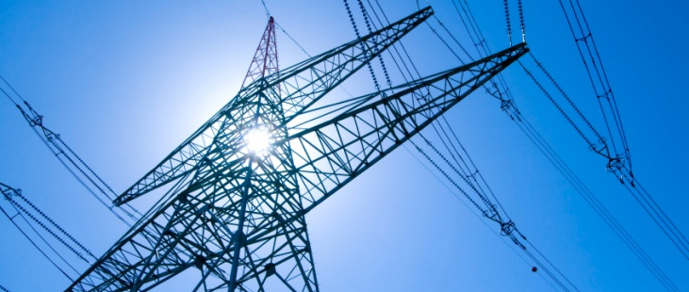


Wastewater: A Resource
Energy
Wastewater
Water
Nutrients
Notes:
New technologies are needed in order to more fully realize wastewater as a resource. Wastewater has the potential to be a source of renewable energy, water, and nutrients. A number of discoveries are enabling advances in technology to recover energy, water and nutrients from wastewater, such as new membrane materials, novel microbial pathways, advanced catalysis, etc.

Slide 36
NYS Center for Clean Water Technology
Co-Directors: Harold Walker, Christopher Gobler
Funding:
State of New York, Suffolk County, and Town of Southampton
Bloomberg Foundation
Mission
Promote a vision of wastewater as a resource, and in particular, a source of water, energy, and valuable feedstocks (e.g., nitrogen and phosphorus).
Develop innovative new water technology, with an initial emphasis on the next generation of nitrogen removal technology for distributed wastewater treatment,
Catalyze the creation of new business focused on clean water technology in the region.

Slide 37
Summary-1
Megacities pose unique challenges. Smart cities could utilize that is produced within city boundaries in an integrated systems approach.
Energy
Natural gas is here to stay for foreseeable future, as a bridge fuel or fugitive gases.
Waste utilization- Low-hanging fruit. Can meet the projected demand from increased population, standard of living while addressing Climate Change.
In the Energy arena, for example, harvesting flared and fugitive CH₄ can mitigate GHGs to replace 3 mboe/d.

Slide 38
Summary-2
Low-temperature waste heat from industry mediated by low temperature reversible reaction could be a key to avoided new resources.
S& T will play a major role. For example, economical skid-mounted units are needed for application in cities with limited available space.
Wastewater
Harvesting energy, water and nutrients provides an opportunity.

