Slide 1
Assessment Day
August 30, 2017
Notes:
Mark-Welcoming opening speech-

Slide 2
Agenda:
Report AY 16-17 annual program assessment report
Oral communication results and Information literacy initiative
Middle States expectations and future program effectiveness assessment
Strategic Plan and Self-Study

Slide 3
AY 16-17 Assessment Report
Updated program level learning outcomes.
Updated assessment matrix, which connect program learning outcomes to course learning outcomes.
Aligned program level learning outcome to institutional educational goals.
Summarized past three years assessment informed actions in improving students learning.
Assessed at least two program level learning outcomes.
Report oral communication assessment results.

Slide 4
AY 16-17 Assessment Report
64 degree programs at all levels (Bachelor level and Master level) from both New York and global campus submitted reports, 57 completed, 7 partially complete.
SOM reports (9) is due 9/15/2017
NYITCOM (6) due 10/31/2017

Slide 5
AY 16-17 Professional Accreditation Self-study
School of Engineering and Computer Sciences
4 B.S., Programs-CS, ECE, ECET, ME-Program Self-Study to ABET
NYITCOM- 3 Reports to COCA
School of Management-AACSB
BSBA & MBA Report to AACSB
School of Architecture and Design
B.Arch. NAAB self-study report for continuing accreditation.
BFA interior design, CIDA report.
School of Health Professions
MS Physician Assistant Report to ARC-PA
D.P.T Report to CAPTE
School of Interdisciplinary Studies and Education
Advanced School leadership and Technology-ELCC
MS Instructional Technology-ISTE
MS Childhood Education-ACEI
Early Childhood Education: NAEYC

Slide 6
NYIT Learning Goals
Gain a coherent understanding of the knowledge, skills, and values of their discipline
Achieve proficiency in oral and written communication, scientific and quantitative reasoning, critical analysis, technological competency, and information literacy
Integrate academic and co-curricular learning to explore concepts and questions that bridge disciplines, professions, and cultures
Formulate evidence-based and ethical courses of action or conclusions to address challenges and problems
Engage with, respond to, and reflect on political, social, environmental and economic challenges at local, national, and global levels
Develop self-efficacy, professionalism, creativity, and an innovative spirit

Slide 7
Programs (used AACU rubric)
Undergraduate-11
BS,BA Business Administration
BS, Psychology
BS, Criminal Justice
BS, Behavioral Sciences (Sociology/Social Work)
BFA Interior Design
English Department Core (FCWR 3xx)
BS Health Sciences/Health & Wellness
BS, Biology
BFA, Computer Graphics
BFA, Graphic Design
BS, Urban Administration
Graduate-9
MBA program
MS, Architecture, Urban and Regional Design
MS, Clinical Nutrition
MSIT, Instructional Technology
MS, School Counseling
MFA, Computer Graphics (Graphic Design, Animation, and Art & Technology)
MS, Energy Management
MFA, Computer Graphics
School Leadership and Technology Advanced Diploma

Slide 8
Oral Communication Assessment Total of 512:
Undergraduates:
320
Graduates:
192

Slide 9
AACU Oral Communication Rubric (scale 1-4)
Rubric Definition: Oral communication is prepared, purposeful presentation designed to increase knowledge, to foster understanding, or to promote change in the listeners’ attitudes, values, beliefs, or behaviors.
Organization
Language
Delivery
Supporting Material
Central Message

Slide 10
 | Capstone 4 | Milestones 3 2 |  | Benchmark 1
Organization | Organizational pattern (specific introduction and conclusion, sequenced material within the body, and transitions) is clearly and consistently observable and is skillful and makes the content of the presentation cohesive. | Organizational pattern (specific introduction and conclusion, sequenced material within the body, and transitions) is clearly and consistently observable within the presentation. | Organizational pattern (specific introduction and conclusion, sequenced material within the body, and transitions) is intermittently observable within the presentation. | Organizational pattern (specific introduction and conclusion, sequenced material within the body, and transitions) is not observable within the presentation.
Language | Language choices are imaginative, memorable, and compelling, and enhance the effectiveness of the presentation. Language in presentation is appropriate to audience. | Language choices are thoughtful and generally support the effectiveness of the presentation. Language in presentation is appropriate to audience. | Language choices are mundane and commonplace and partially support the effectiveness of the presentation. Language in presentation is appropriate to audience. | Language choices are unclear and minimally support the effectiveness of the presentation. Language in presentation is not appropriate to audience.
Delivery | Delivery techniques (posture, gesture, eye contact, and vocal expressiveness) make the presentation compelling, and speaker appears polished and confident. | Delivery techniques (posture, gesture, eye contact, and vocal expressiveness) make the presentation interesting, and speaker appears comfortable. | Delivery techniques (posture, gesture, eye contact, and vocal expressiveness) make the presentation understandable, and speaker appears tentative. | Delivery techniques (posture, gesture, eye contact, and vocal expressiveness) detract from the understandability of the presentation, and speaker appears uncomfortable.
Supporting Material | A variety of types of supporting materials (explanations, examples, illustrations, statistics, analogies, quotations from relevant authorities) make appropriate reference to information or analysis that significantly supports the presentation or establishes the presenter's credibility/authority on the topic. | Supporting materials (explanations, examples, illustrations, statistics, analogies, quotations from relevant authorities) make appropriate reference to information or analysis that generally supports the presentation or establishes the presenter's credibility/authority on the topic. | Supporting materials (explanations, examples, illustrations, statistics, analogies, quotations from relevant authorities) make appropriate reference to information or analysis that partially supports the presentation or establishes the presenter's credibility/authority on the topic. | Insufficient supporting materials (explanations, examples, illustrations, statistics, analogies, quotations from relevant authorities) make reference to information or analysis that minimally supports the presentation or establishes the presenter's credibility/authority on the topic.
Notes:
Rubric from AAC&U – validity and reliability well-established, widely used

Slide 11
Results for 320 Undergraduate Students

Slide 12
Undergraduate Area to Improve - Delivery (2.97/4.0)
4/4:Delivery techniques (posture, gesture, eye contact, and vocal expressiveness) make the presentation compelling, and speaker appears polished and confident.
Notes:
Pause for discussion

Slide 13
Results for 192 Graduate Students

Slide 14
Graduate Area to Improve - Language (3.12/4.0)
4/4-Language choices are imaginative, memorable, and compelling, and enhance the effectiveness of the presentation. Language in presentation is appropriate to audience.

Slide 15
Other Communication Skill Assessment Report
B. Arch Program Report_SPC-A1 -Ability to write and speak effectively and use appropriate representational media both with peers and with the general public.
Five courses (AAID 160, ARCH 361, 362, 501, 502) 23 sections were assessed – approximately 300 students.
“2017 NAAB Team Assessment: This criterion is met with Distinction. …..The thesis research documentation was exemplary.”

Slide 16
NYIT Learning Goals
Gain a coherent understanding of the knowledge, skills, and values of their discipline
Achieve proficiency in oral and written communication, scientific and quantitative reasoning, critical analysis, technological competency, and information literacy
Integrate academic and co-curricular learning to explore concepts and questions that bridge disciplines, professions, and cultures
Formulate evidence-based and ethical courses of action or conclusions to address challenges and problems
Engage with, respond to, and reflect on political, social, environmental and economic challenges at local, national, and global levels
Develop self-efficacy, professionalism, creativity, and an innovative spirit

Slide 17
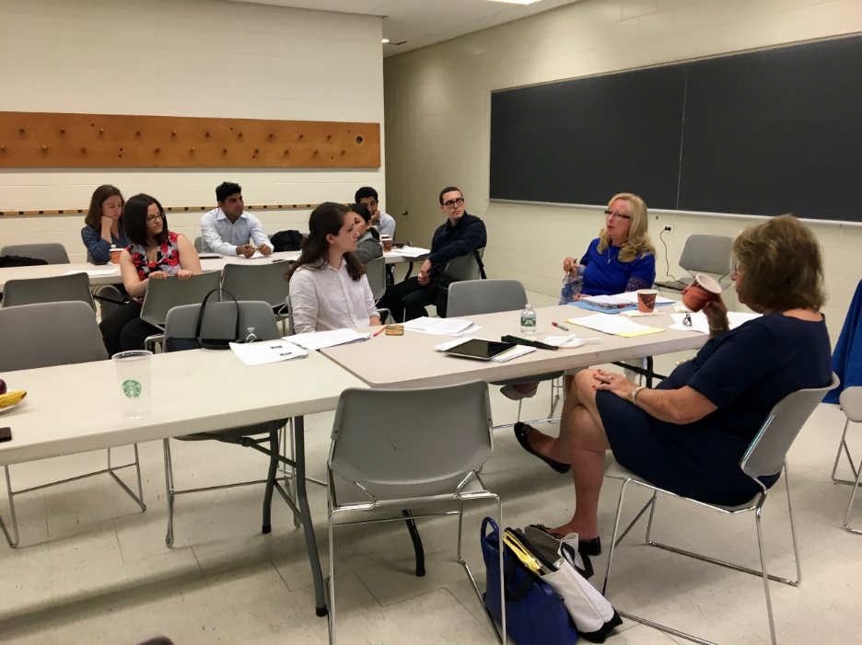
Information Literacy Assessment Initiative
The goal
The process
The workshop evaluation
The participants:
4 librarians: Danielle Apfelbaum, David Cirella, Naomi Binnie, Vanessa Viola
14 Faculty: Dina Karafantis, Susan Neville Maureen Cardoza, Melda Yildiz, Aydin Farajidavar, Maherukh Akhtar, Amanda Golden, xsReza Khalaj Amineh, John DiDomenico, Jeffrey Raven,Wenjia Li, Nabi Sertac Artan, Houwei Cao, Paolo Gasti

Slide 18
Middle States Expectations for Program-Level Learning Outcomes
Assessments of Institutional Learning & Achievement Goals
Demonstrates and improves institution’s learning and achievement goals.
Program Learning Outcome Assessments
Demonstrates and improves learning outcomes in programs.
Curriculum Mapping
Ensures that program curriculum adequately addresses all program learning goals.
Course-based Assessments
Demonstrates and improves learning outcomes in courses.
Notes:
Mark

Slide 19
Expectations Continued
What we are looking for regarding your program level learning outcomes (PLOs) themselves:
Review and revise on a regular basis
Development of learning outcome assessment

Slide 20
Assessment of Student Learning Has Come a Long Way
Science and Engineering Area
The Carl Wieman Science Education Initiative - http://bit.ly/2xxPje5
Social Science Area
Social Science Research Council (Measuring College Learning Project) - http://bit.ly/2wSXLr4 In the Health Science Area AAMC Scientific Foundation for Future Physicians: Scientific foundation for future physicians - http://bit.ly/2wSV9d0

Slide 21
Expectations Continued
What we are looking for regarding the methods you use to measure students’ progress in meeting PLOs, and in your assessment results and analysis of the assessment data you collect regarding your PLOs:

Slide 23
Expectations Continued
What we are looking for regarding how you use your assessment results to improve your program and your achievement of learning outcomes, and the effectiveness of your program improvement plan once it has been implemented:

Slide 24
Expectations Continued
What we are looking for regarding your faculty’s involvement in the entire process:

Slide 25
The Future Program Effectiveness Assessment
It should be based on your program’s mission and goals.
It should be continuous effort to improve both learning and students success.

Slide 26
NYIT Strategic Planning and Middle States Study
Two very important activities will be going on simultaneously this fall:
NYIT will begin a year-long self-study process as required by Middle States as part of our 2019 reaccreditation.
NYIT will develop a new strategic plan as called for by our Board of Trustees and President.
Both activities will require the use of assessment data – not just of academic programs, but also of administrative functions and academic and student support services.
Given the tight timeframe, it is critical that these two activities be well-coordinated.

Slide 27
NYIT’s Middle States Self-Study
The Self-Study has three basic layers:
Demonstrating compliance with relevant regulations and commonly held academic and administrative standards.
Demonstrating compliance with the seven Middle States accreditation standards.
Mission and Goals
Ethics and Integrity
Design and Delivery of the Student Learning Experience
Support of the Student Experience
Educational Effectiveness Assessment
Planning, Resources, and Institutional Improvement
Governance, Leadership, and Administration
A deeper inquiry into a handful of questions or self-study themes identified by NYIT.

Slide 28
NYIT’s Self-Study Themes
Through the work of the 7 Working Groups four themes have been identified:
Scope, Size, Quality - What we do, we will do well, do sustainably, and with high quality.
Organizational, Operational, and Physical Infrastructure - We will ensure that we are well-positioned to deliver on our promises.
Assessment, Planning, and Resource Allocation - We will ensure that our priorities are reflected in the decisions we make.
Climate, Culture, and Motivation – We will strive to empower all members of our community to do their best work by practicing the values of trust, transparency, institutional pride, collaboration, and thoughtfulness in everything we do.

Slide 29
NYIT’s New Strategic Plan
We will continue to implement the initiatives of the 2030 2.0 plan, as these position us to attain a more vision-driven set of strategies for the institution.
We will develop those strategies over the coming months, with the following areas of focus:
Creating the best student experience possible in a commuter-school setting
Developing a broader view of faculty work in research and other scholarship
Developing a physical plan and IT infrastructure to support this work and to truly earn the name “Institute of Technology.”

